Slide 1

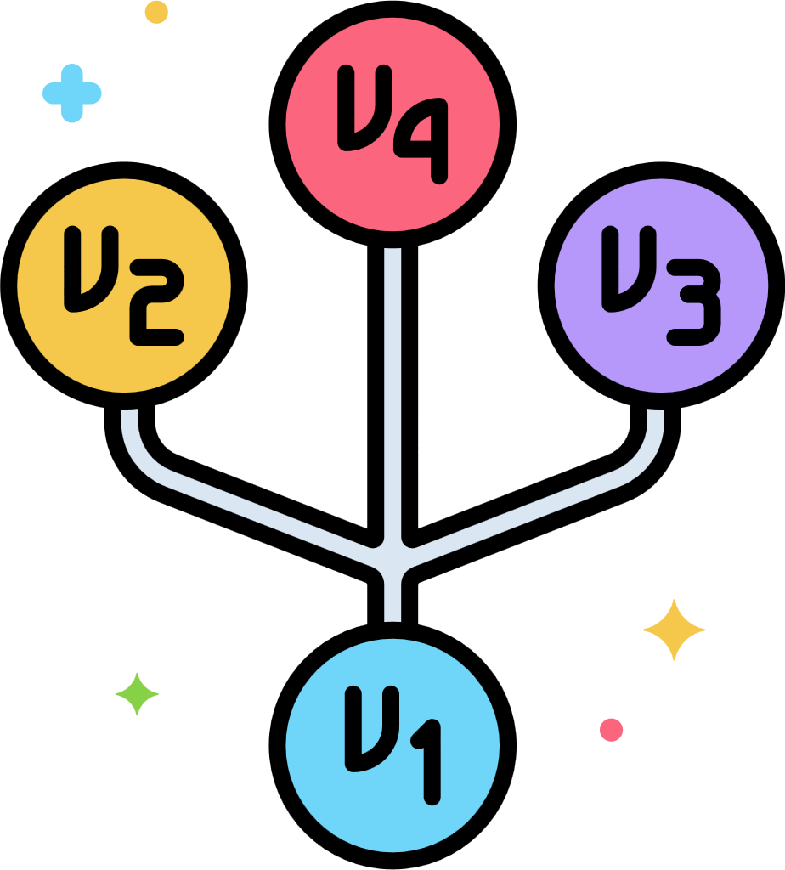

Version
Control

Slide 2

VERSION CONTROL
Version control is a system that records changes to a file or set of files over time so that you can recall specific versions later.
Also, version control systems are software tools that help software teams manage changes to source code over time. As development environments have accelerated, version control systems help software teams work faster and smarter. They are especially useful for DevOps teams since they help them to reduce development time and increase successful deployments.

Slide 3
Why do you think using version control is important?
Notes:
Backup and Recovery:
Version control serves as a backup mechanism. If data is lost, corrupted, or a mistake is made, it's possible to revert to a previous, known-good state. This helps prevent data loss and minimizes downtime.
Documentation: Version control can include commit messages or comments that document why changes were made.

Slide 4

Timeline of Version Control
Manual File Copying
Source Code Control System (SCCS - 1970)
Revision Control System (RCS - 1980)
Centralized Versions Control System (CVS - 1980)
Subversion (SVN - 2000)
Git (2005)
Notes:
Manual Copying
Developed by AT&T Bell Labs in the 1970s, was one of the earliest version control systems for source code
was developed in the early 1980s and improved upon SCCS
created in the 1980s, was one of the first widely adopted version control systems. It introduced a client-server model and allowed multiple developers to collaborate on the same project concurrently.
released in the early 2000s, aimed to address some of the limitations of CVS.
created by Linus Torvalds in 2005, revolutionized version control. It introduced a distributed model, enabling developers to work offline, branch and merge effortlessly, and collaborate more effectively.

Slide 5
Local Version Control Systems
Many people’s version-control method of choice is to copy files into another directory (perhaps a time-stamped directory, if they’re clever). This approach is very common because it is so simple, but it is also incredibly error prone. It is easy to forget which directory you’re in and accidentally write to the wrong file or copy over files you don’t mean to.
To deal with this issue, programmers long ago developed local VCSs that had a simple database that kept all the changes to files under revision control.

Slide 6
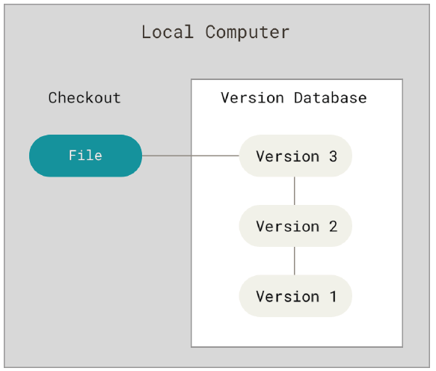
Local Version Control Systems
One of the most popular VCS tools was a system called RCS (Revision Control System), which is still distributed with many computers today. RCS works by keeping patch sets (that is, the differences between files) in a special format on disk; it can then re-create what any file looked like at any point in time by adding up all the patches.

Slide 7
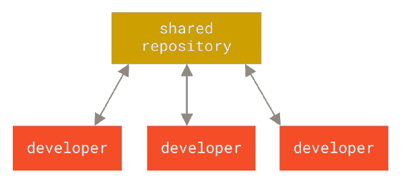
Centralized Version Control Systems
The next major issue that people encounter is that they need to collaborate with developers on other systems. To deal with this problem, Centralized Version Control Systems (CVCSs) were developed. These system have a single server that contains all the versioned files, and a number of clients that check out files from that central place. For many years, this has been the standard for version control.

Slide 8
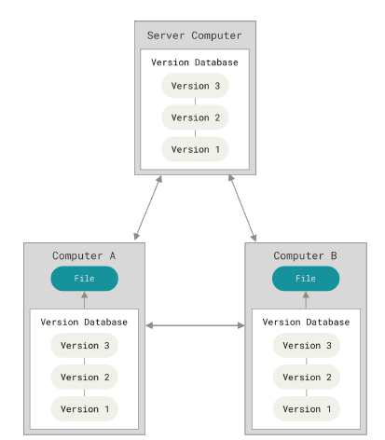
Distributed Version Control Systems
In a DVCS (such as Git, Mercurial, Bazaar or Darcs), clients don’t just check out the latest snapshot of the files; rather, they fully mirror the repository, including its full history. Thus, if any server dies, and these systems were collaborating via that server, any of the client repositories can be copied back up to the server to restore it. Every clone is really a full backup of all the data.

Slide 9

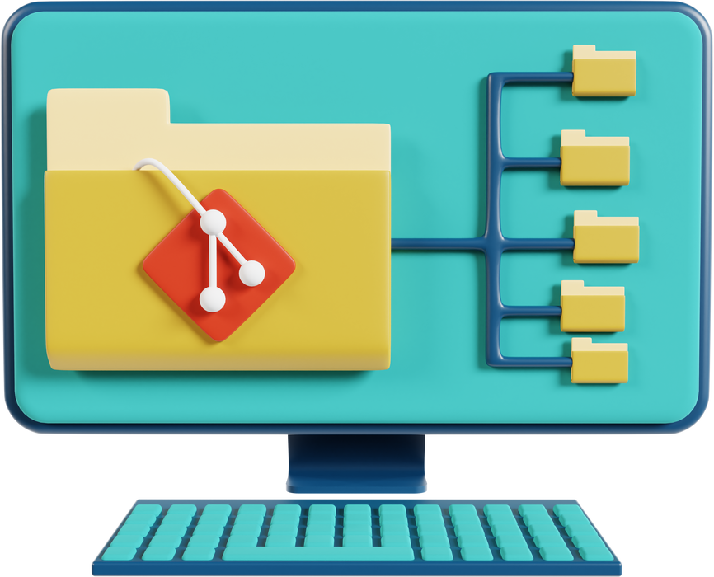
GIT

Slide 10

A Short History of Git
In 2002, the Linux kernel project began using a proprietary DVCS called BitKeeper.
In 2005, the relationship between the community that developed the Linux kernel and the commercial company that developed BitKeeper broke down, and the tool’s free-of-charge status was revoked. This prompted the Linux development community (and in particular Linus Torvalds, the creator of Linux) to develop their own tool based on some of the lessons they learned while using BitKeeper. Some of the goals of the new system were as follows:
• Speed
• Simple design
• Strong support for non-linear development (thousands of parallel branches)
• Fully distributed
• Able to handle large projects like the Linux kernel efficiently (speed and data size)

Slide 11
What is GIT?
By far, the most widely used modern version control system in the world today is Git. Git is a mature, actively maintained open source project originally developed in 2005 by Linus Torvalds, the famous creator of the Linux operating system kernel. A staggering number of software projects rely on Git for version control, including commercial projects as well as open source. Developers who have worked with Git are well represented in the pool of available software development talent and it works well on a wide range of operating systems and IDEs (Integrated Development Environments).
Having a distributed architecture, Git is an example of a DVCS (hence Distributed Version Control System). Rather than have only one single place for the full version history of the software as is common in once-popular version control systems like CVS or Subversion (also known as SVN), in Git, every developer's working copy of the code is also a repository that can contain the full history of all changes.
In addition to being distributed, Git has been designed with performance, security and flexibility in mind.

Slide 12
The Three States
Git has three main states that your files can reside in: modified, staged, and committed:
Modified means that you have changed the file but have not committed it to your database yet.
Staged means that you have marked a modified file in its current version to go into your next commit snapshot.
Committed means that the data is safely stored in your local database.

Slide 13

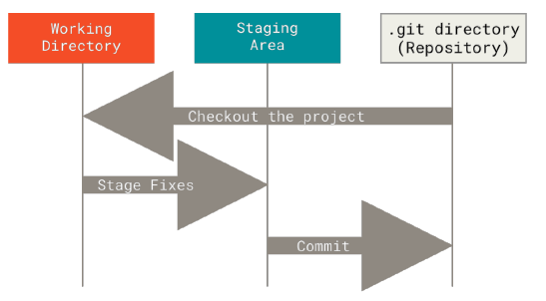
The Three Main Sections
The working tree is a single checkout of one version of the project. These files are pulled out of the compressed database in the Git directory and placed on disk for you to use or modify.
Notes:
This is the directory on your local file system where you edit and manipulate your project's files. It contains the actual files and directories that you see and work with.

Slide 14
The Three Main Sections
The staging area is a file, generally contained in your Git directory, that stores information about what will go into your next commit. Its technical name in Git parlance is the “index”, but the phrase “staging area” works just as well.
Notes:
It serves as an intermediate step between your working tree (the directory with your project's files) and the Git repository (where Git stores the history of your project).
It acts as a place where you can selectively choose which changes you want to include in your next commit.

Slide 15
The Three Main Sections
The Git directory is where Git stores the metadata and object database for your project. This is the most important part of Git, and it is what is copied when you clone a repository from another computer.
Notes:
is the heart of your version control system. It's a hidden directory located at the root of your project, and it contains all the data and metadata that Git uses to manage your project's history.

Slide 16
THE BASIC GIT WORKFLOW
The basic Git workflow goes something like this:
1. You modify files in your working tree.
2. You selectively stage just those changes you want to be part of your next commit, which adds only those changes to the staging area.
3. You do a commit, which takes the files as they are in the staging area and stores that snapshot permanently to your Git directory.

Slide 17
THE BASIC GIT WORKFLOW
The basic Git workflow goes something like this:
1. You modify files in your working tree.
2. You selectively stage just those changes you want to be part of your next commit, which adds only those changes to the staging area.
3. You do a commit, which takes the files as they are in the staging area and stores that snapshot permanently to your Git directory.
pull or checkout the project for the possible changes
Modify a file
File that’s not yet commited
A commited file

Slide 18
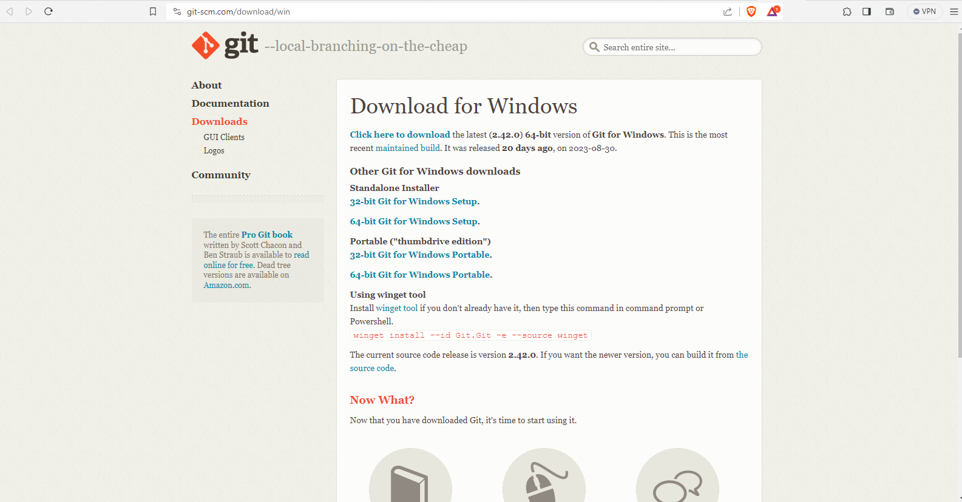
GIT WINDOWS INSTALLATION
https://git-scm.com/download/win

Slide 19
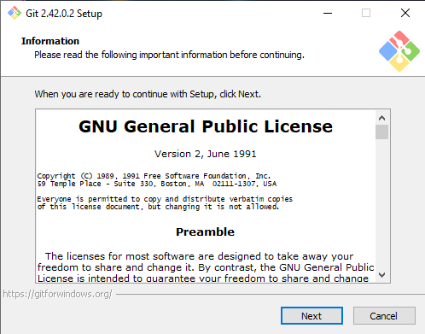
GIT WINDOWS INSTALLATION

Slide 20
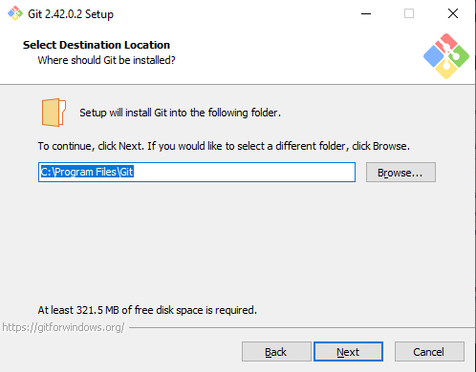
GIT WINDOWS INSTALLATION

Slide 21
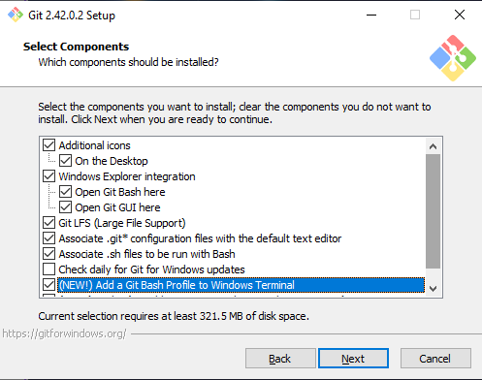
GIT WINDOWS INSTALLATION

Slide 22
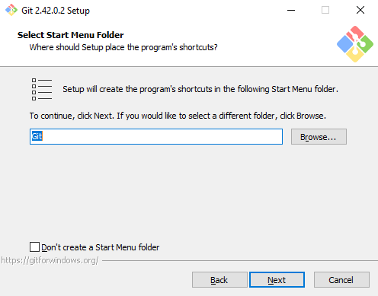
GIT WINDOWS INSTALLATION

Slide 23
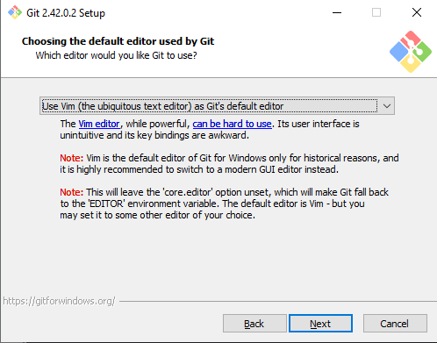
GIT WINDOWS INSTALLATION

Slide 24
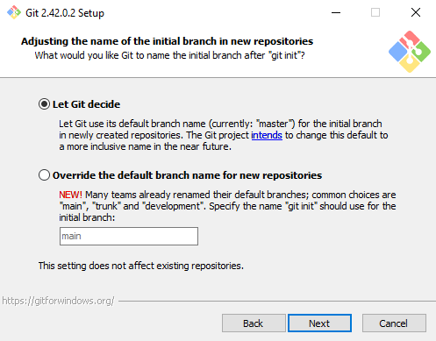
GIT WINDOWS INSTALLATION

Slide 25
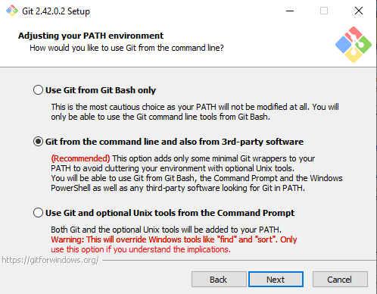
GIT WINDOWS INSTALLATION

Slide 26
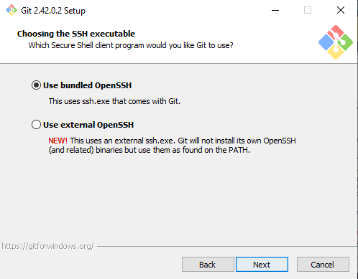
GIT WINDOWS INSTALLATION

Slide 27
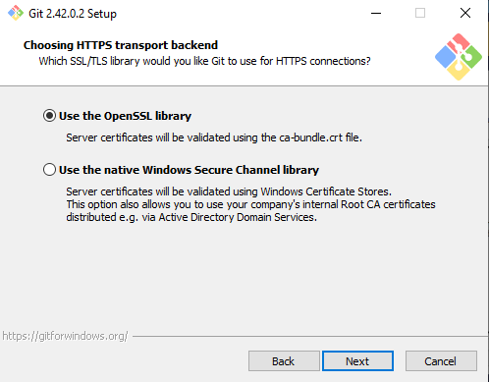
GIT WINDOWS INSTALLATION

Slide 28
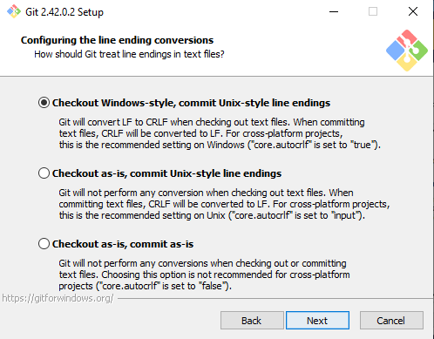
GIT WINDOWS INSTALLATION

Slide 29
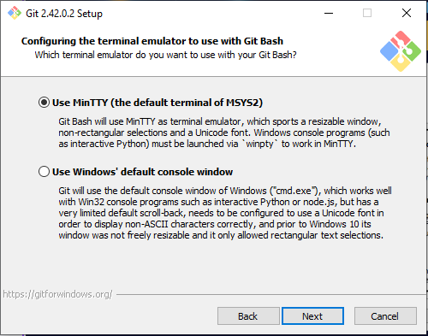
GIT WINDOWS INSTALLATION

Slide 30
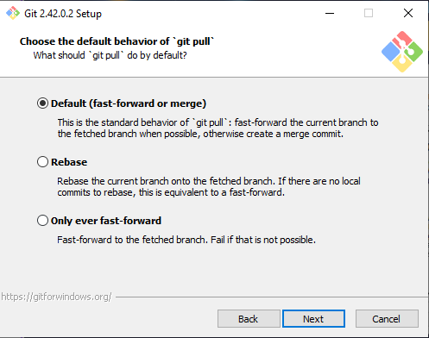
GIT WINDOWS INSTALLATION

Slide 31
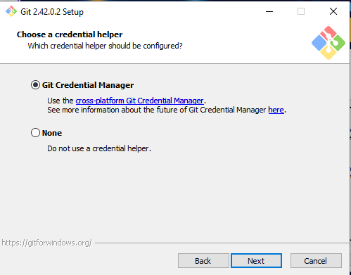
GIT WINDOWS INSTALLATION

Slide 32
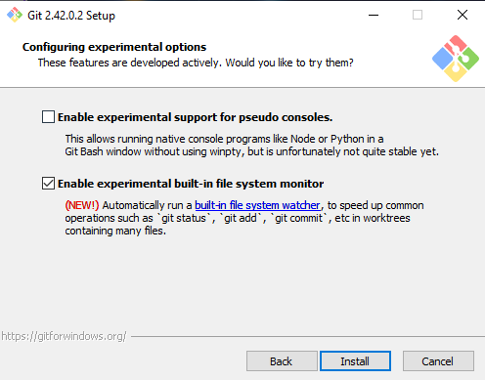
GIT WINDOWS INSTALLATION

Slide 33
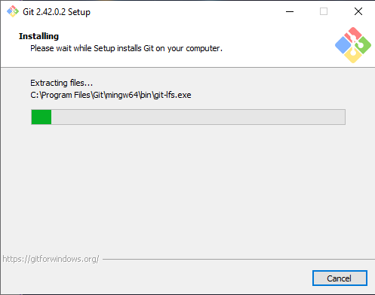
GIT WINDOWS INSTALLATION

Slide 34
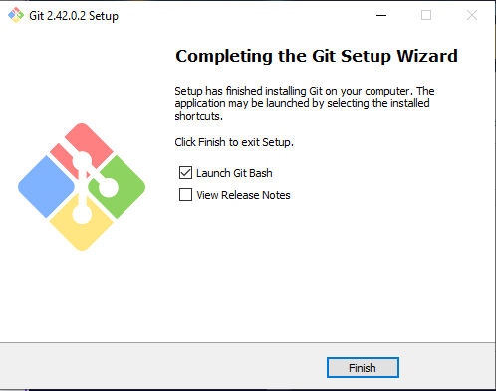
GIT WINDOWS INSTALLATION

Slide 35
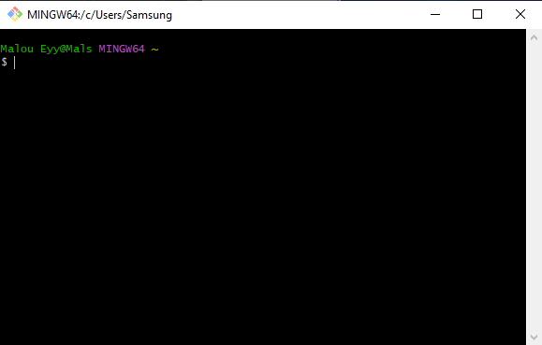
GIT WINDOWS INSTALLATION

Slide 36
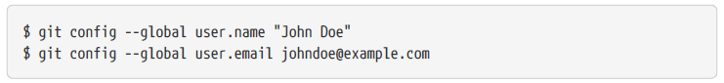
Configuring Git
The first thing you should do when you install Git is to set your user name and email address. This is important because every Git commit uses this information, and it’s immutably baked into the commits you start creating:
Again, you need to do this only once if you pass the --global option, because then Git will always use that information for anything you do on that system. If you want to override this with a different name or email address for specific projects, you can run the command without the --global option when you’re in that project.

Slide 37
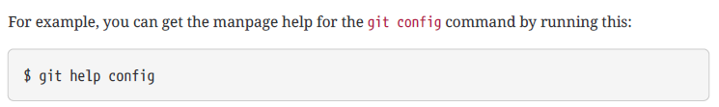
Getting Help
If you ever need help while using Git, there are three equivalent ways to get the comprehensive
manual page (manpage) help for any of the Git commands:
These commands are nice because you can access them anywhere, even offline. In addition, if you don’t need the full-blown manpage help, but just need a quick refresher on the available options for a Git command, you can ask for the more concise “help” output with the -h option, as in:

Slide 38

The Command Line
There are a lot of different ways to use Git. There are the original command-line tools, and there are many graphical user interfaces of varying capabilities.
For one, the command line is the only place you can run all Git commands — most
of the GUIs implement only a partial subset of Git functionality for simplicity.

Slide 39

REAL EXAMPLE OF GIT WORKFLOW
Staging Area
.git repository
pull or checkout the project for the possible changes
File1
File2
File1
File2
Modify a file
File1
File2
Git add File1 File2
Git commit –m “Initial commit”
Git init

Slide 40
Basic Git Commands
git init -To take a directory and turn it into a new Git repository so you can start version controlling it, you can simply run git init.
git add - The git add command adds content from the working directory into the staging area (or “index”) for the next commit. When the git commit command is run, by default it only looks at this staging area, so git add is used to craft what exactly you would like your next commit snapshot to look like.
git status - The git status command will show you the different states of files in your working directory and staging area. Which files are modified and unstaged and which are staged but not yet committed. In its normal form, it also will show you some basic hints on how to move files between these stages.
git commit - The git commit command takes all the file contents that have been staged with git add and records a new permanent snapshot in the database and then moves the branch pointer on the current branch up to it.

Slide 41
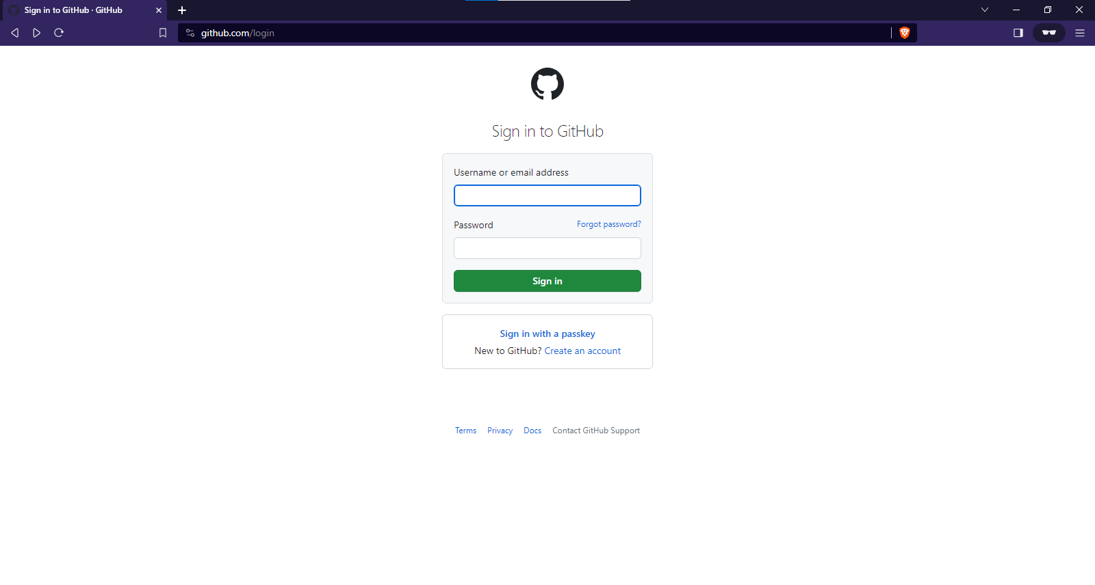
CREATING A GITHUB ACCOUNT

Slide 42
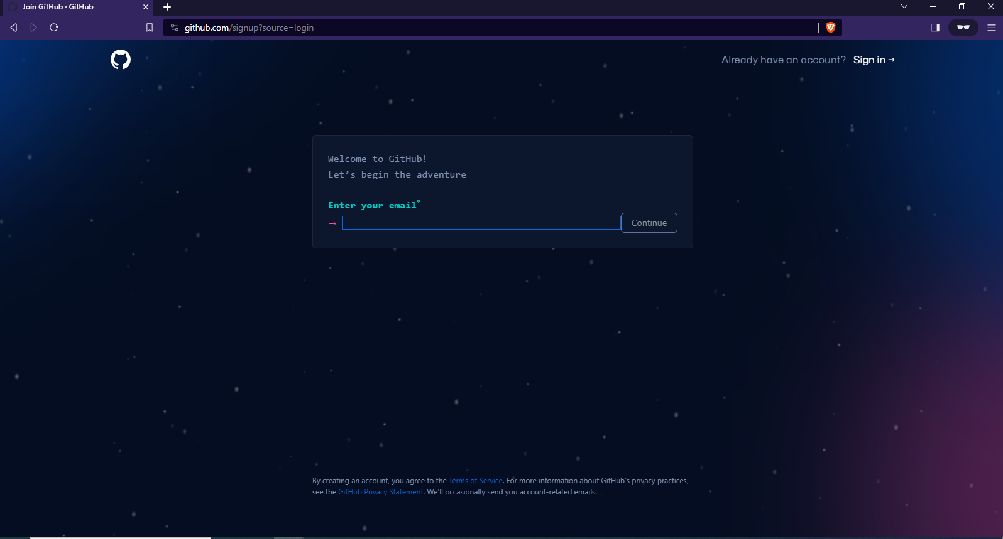
CREATING A GITHUB ACCOUNT

Slide 43
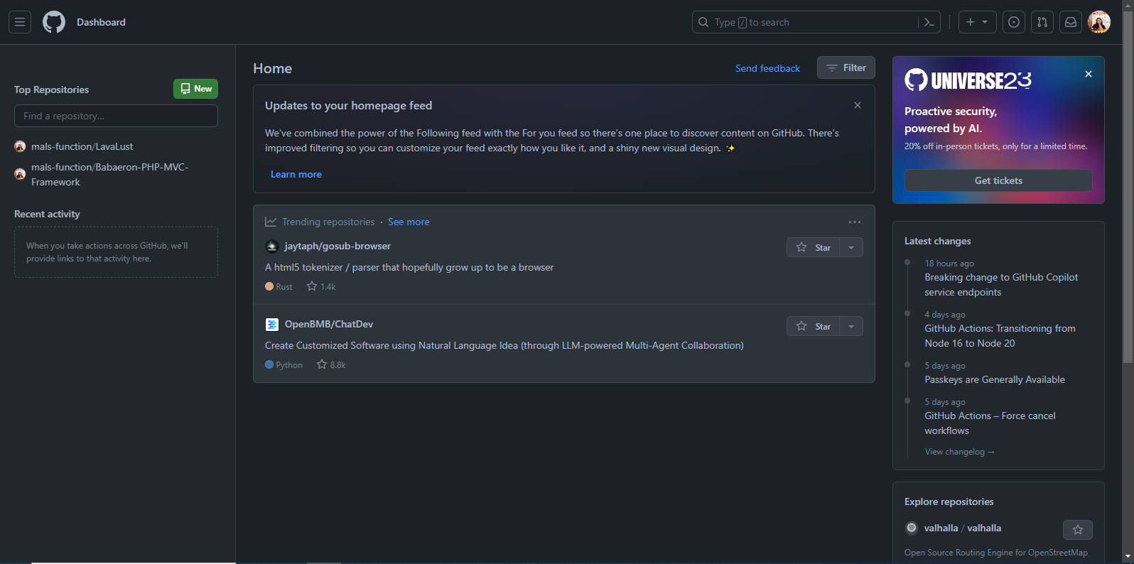
CREATING A GITHUB ACCOUNT

Slide 44
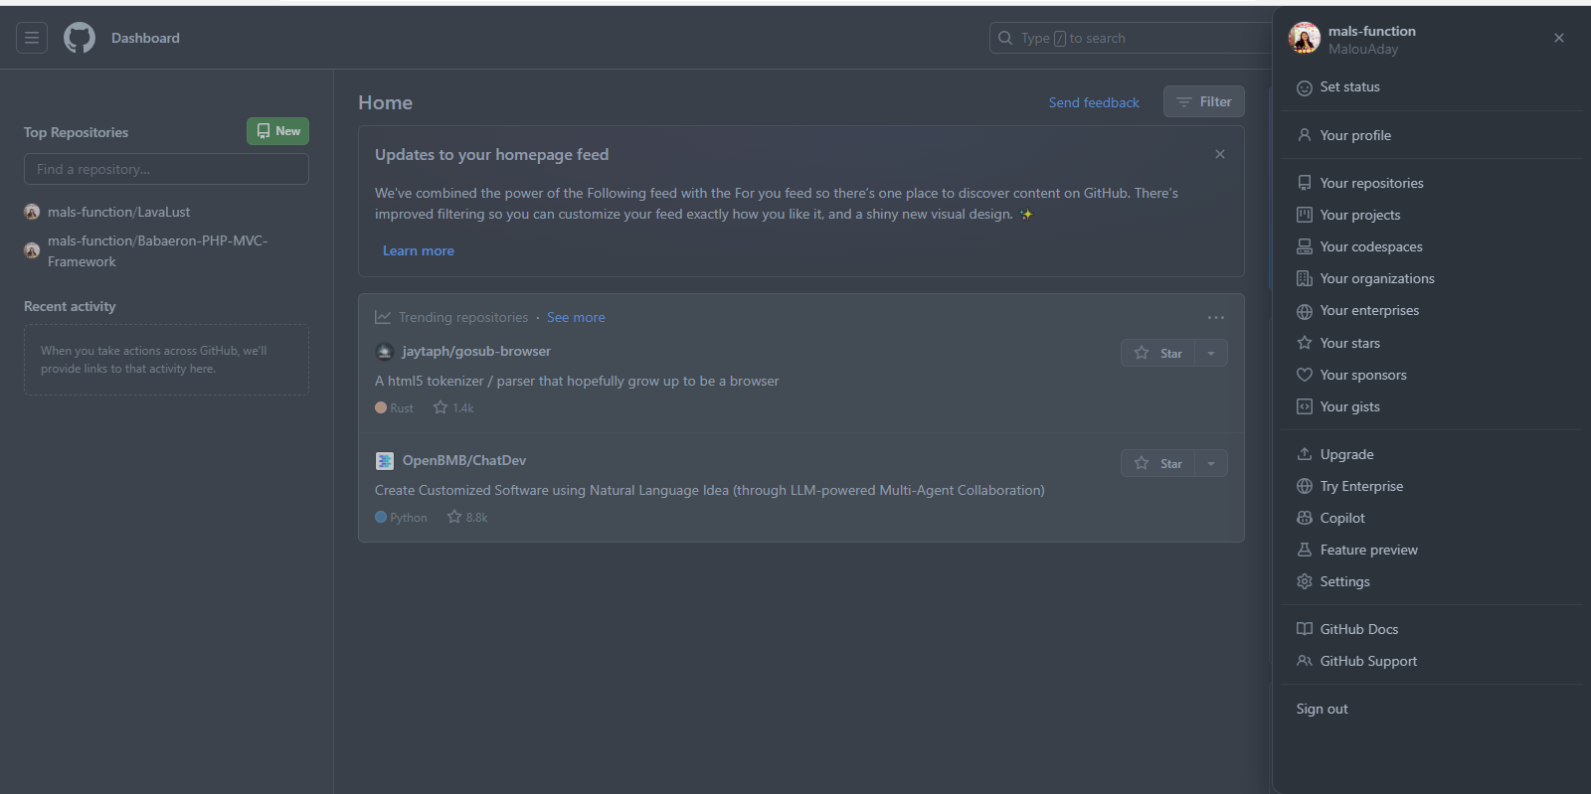
CREATING A NEW REPOSITORY

Slide 45
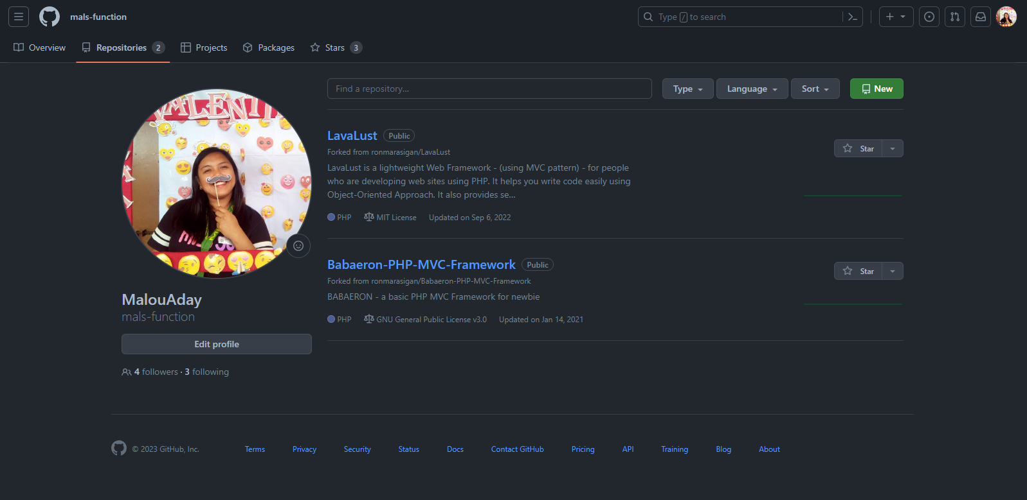
CREATING A NEW REPOSITORY

Slide 46
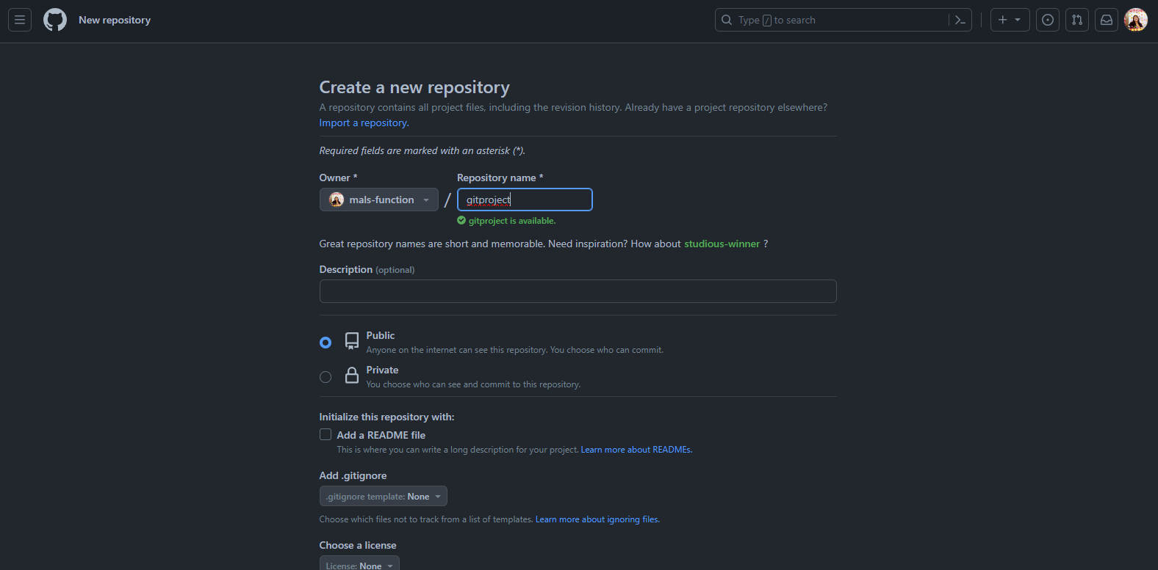
CREATING A NEW REPOSITORY

Slide 47
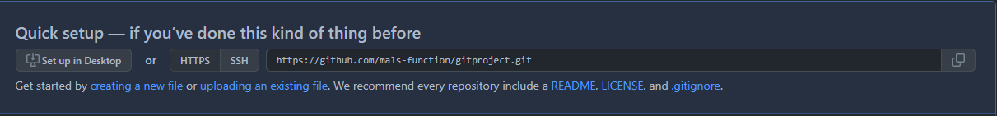
CREATING A NEW REPOSITORY
Notes:
Link of your remote repo, make sure HTTPS is selected.

Slide 48
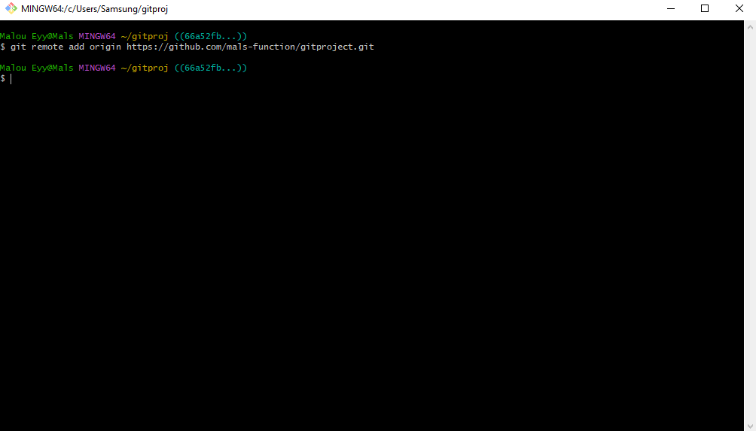
REMOTE REPOSITORY / BACKUP
Notes:
Git remote add (name/alias of your repo) (link of repo) – to add your remote repository

Slide 49
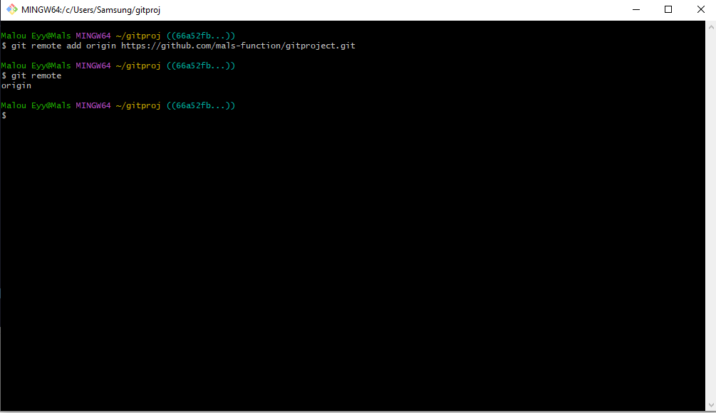
CHECKING OF REMOTE REPOSITORY
Notes:
Git remote – to check your existing repository

Slide 50
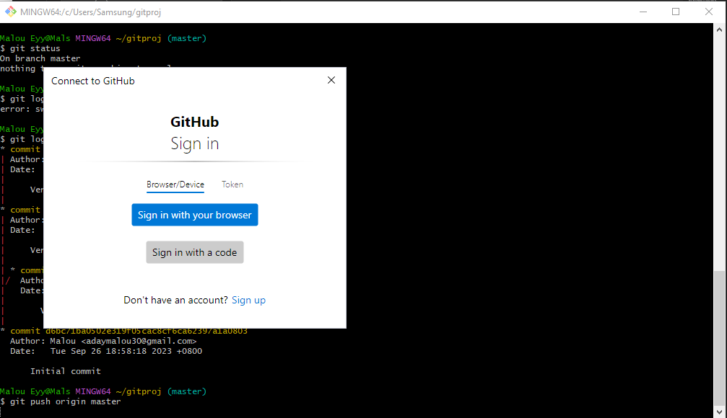
UPLOADING OF LOCAL VERSION TO REMOTE REPOSITORY
Notes:
Git push (name/alias of your remote repo) (name of your branch: master is the default)

Slide 51
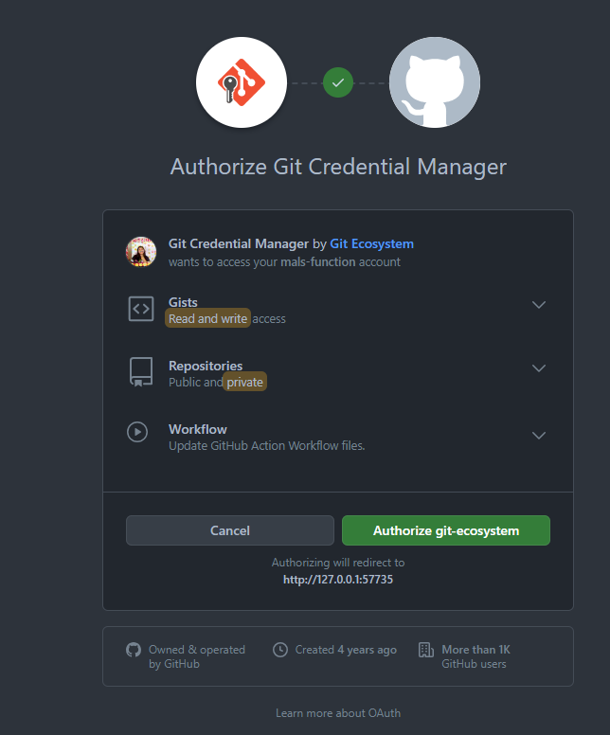
AUTHORIZATION

Slide 52
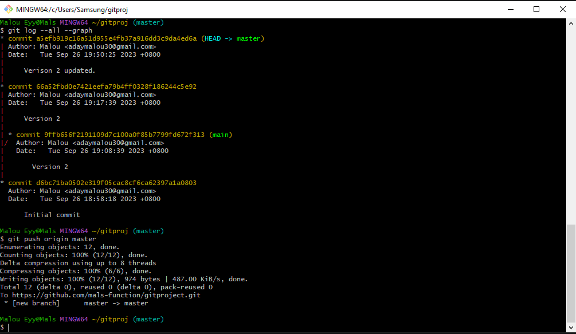
UPLOADING / COMPLETED
Notes:
Status of your git push

Slide 53

STAR and FORK
Star – or starring a repository on GitHub is a way to bookmark or mark it as interesting or valuable to you. It's similar to adding a repository to your favorites or watchlist.
Fork - Forking a repository on GitHub creates a copy of the repository under your GitHub account. It allows you to freely modify, experiment with, and contribute to the codebase without affecting the original repository.

